Slide 1

The Changing Newsroom

Slide 2
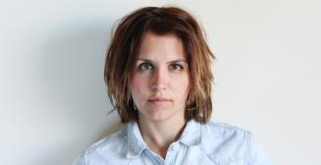
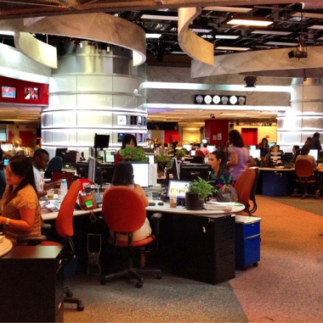
A bit about me
Currently the online host for CBC Kitchener-Waterloo.
I’ve worked as a producer in TV news, as a reporter/photographer for a wire service, an assistant film editor, in online news and radio.

Slide 3
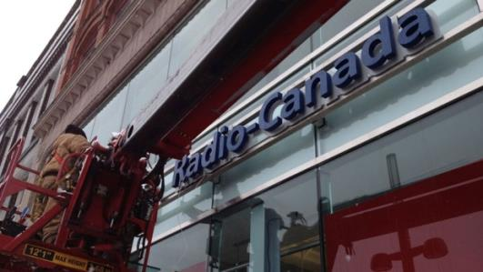
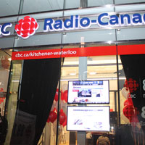
CBC Kitchener-Waterloo
The first new CBC Radio station in Ontario in 35 years. Last was CBCS Sudbury in 1978.

Slide 4
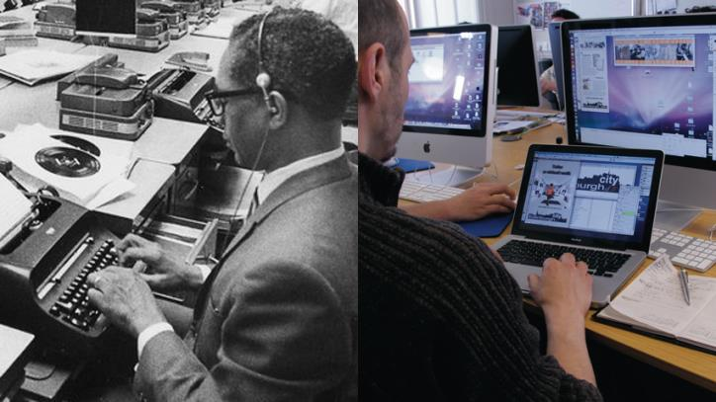
Then and now

Slide 5
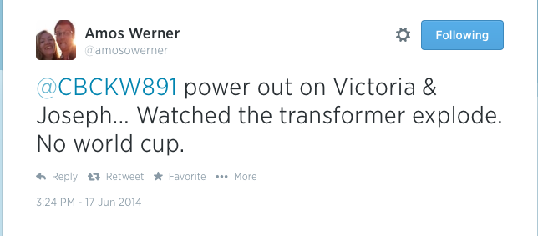
The changing media landscape
We’re no longer the voice from on high
We must be interactive and responsive
Outlets that aren’t responsive lose opportunities

Slide 6
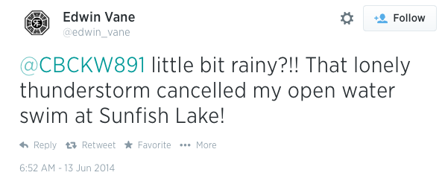
Conversations
Story ideas suggested by the public
What are people are talking about?
What’s happening in the area?
What do you think of our coverage?
Breaking news

Slide 7

The most important tool for journalists

Slide 8
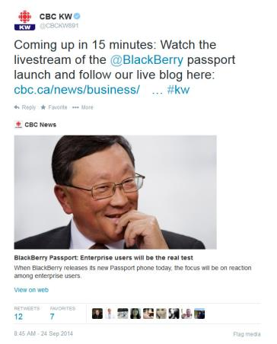
Why we use Twitter
Find breaking news and chase potential sources
Create and interact with site community
Share our stories and updates
Corrections

Slide 9
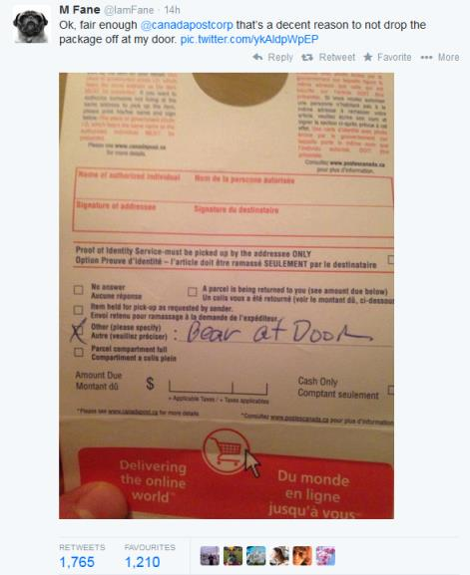

Slide 10

Facebook
Can use Facebook to supplement searches
Not as open, so not as useful
Facebook algorithms constantly change

Slide 11
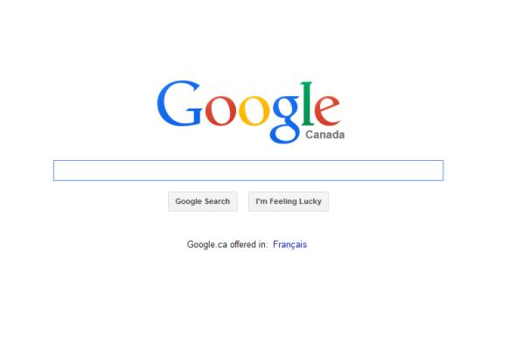
How do you find someone?

Slide 12
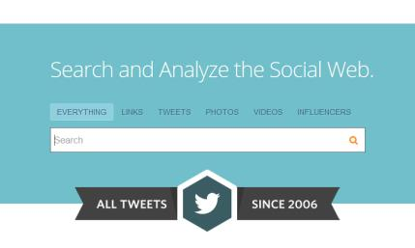
Narrow it down
Topsy is your friend
Search on Google using name, location, phone number prefixes
Search on Twitter by keywords, hashtags and user

Slide 13
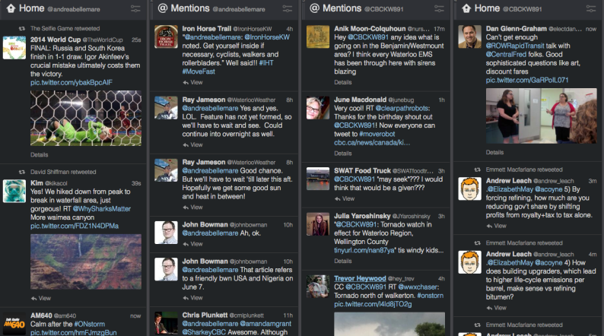
Geocode Search

Slide 14
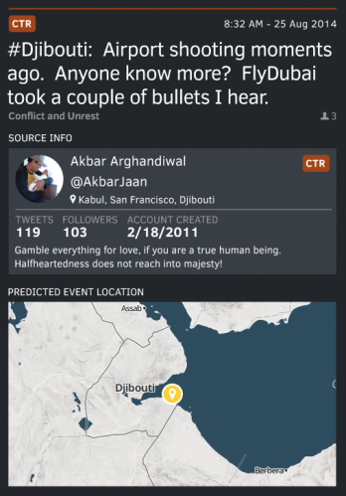

New tools

Slide 15
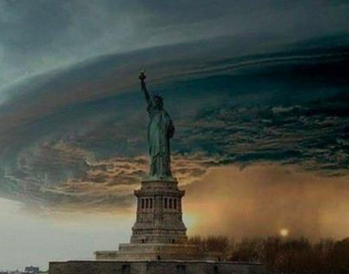

Is it real? Verify, Verify, Verify

Slide 16
Is it real?
When was it posted? Where?
Are others in the area posting about this?
What do you know about the user? When did they join the network? What do their other posts look like?
Can you ask someone who knows the area? The story?
Does it look familiar?
Is it too good to be true?

Slide 17

Google image search

Slide 18
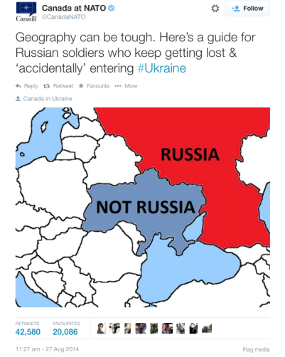
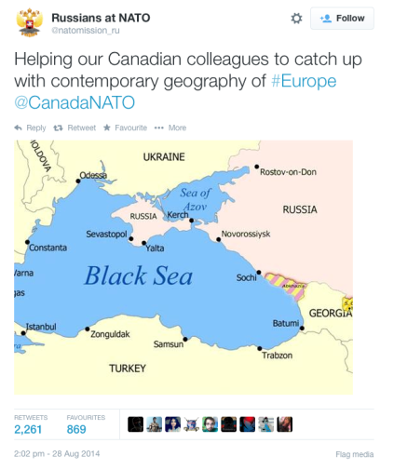
Canada V Russia on Twitter

Slide 19
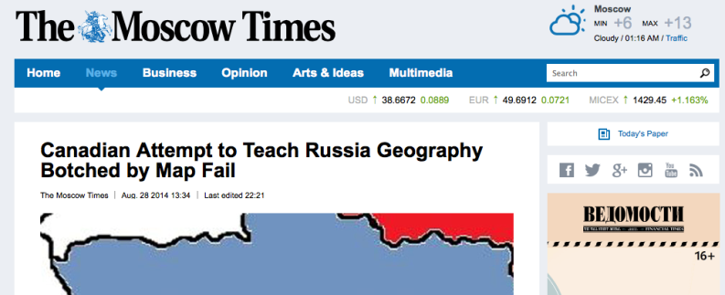
Canada V Russia on Twitter

Slide 20
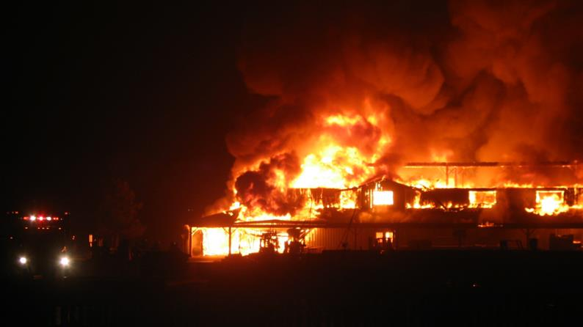
St. Jacobs Market Fire

Slide 21
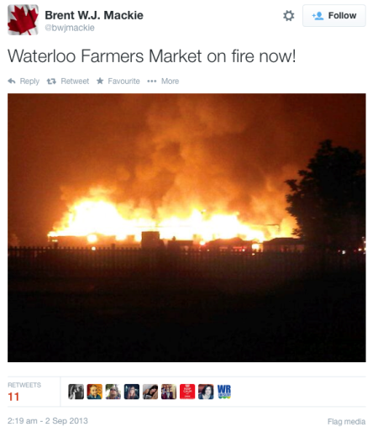
The tweet we saw

Slide 22


Naheed Nenshi and the Calgary Floods

Slide 23

Naheed Nenshi and the Calgary Floods

Slide 24
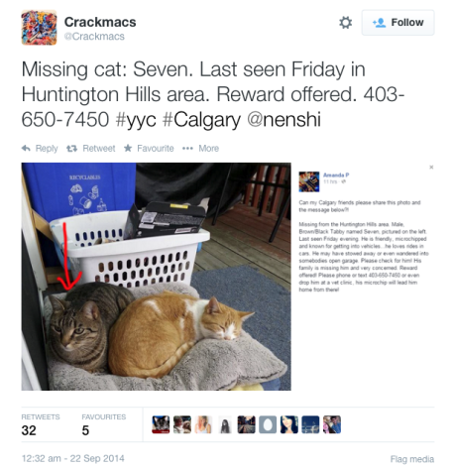
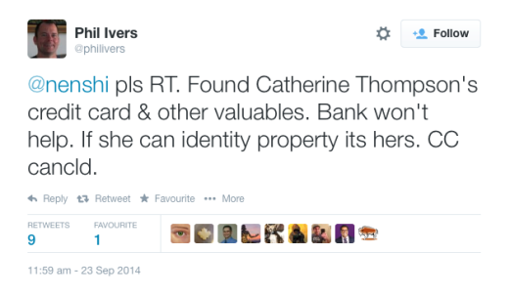
Nenshi now

Slide 25
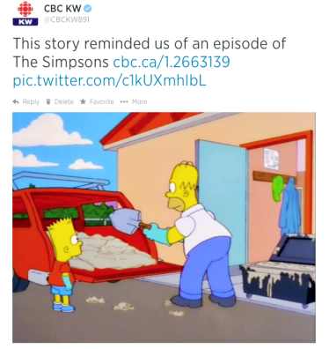
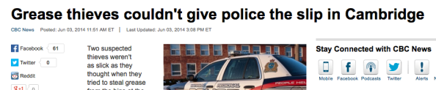
Fun

