Slide 1


SOCIAL MEDIA CRISIS

Slide 2
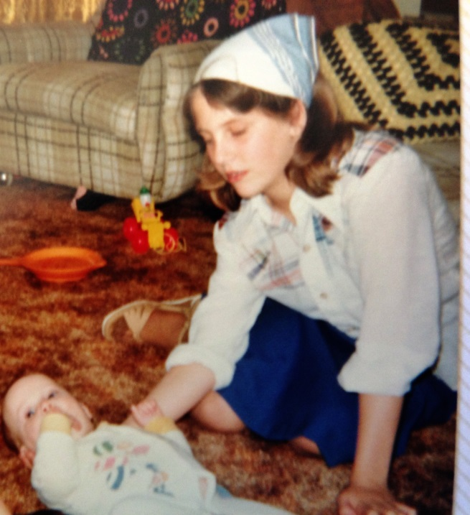
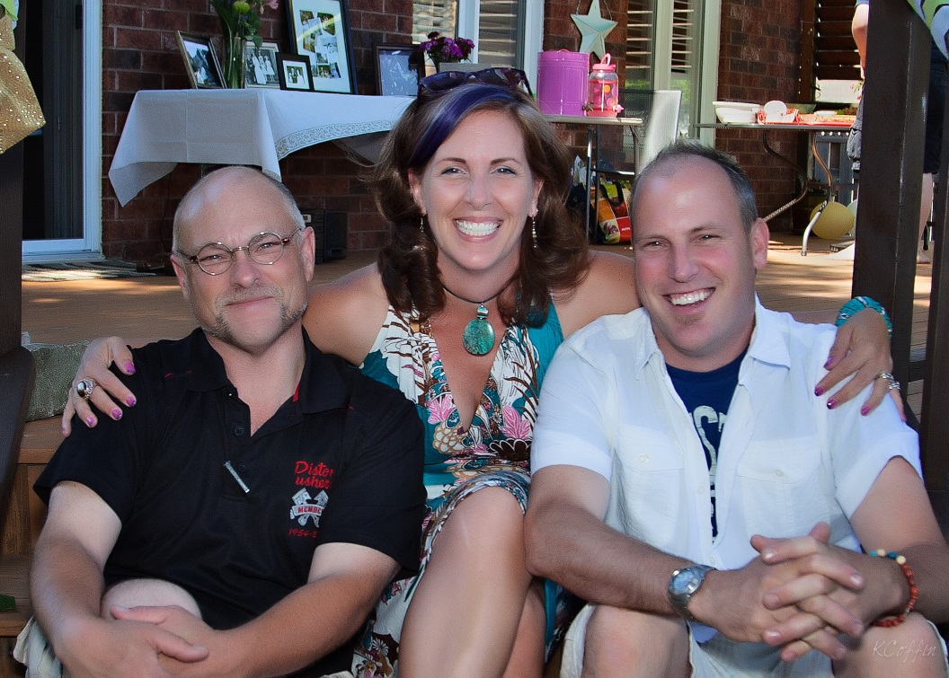
you can fake success
you can’t fake significance…

Slide 3
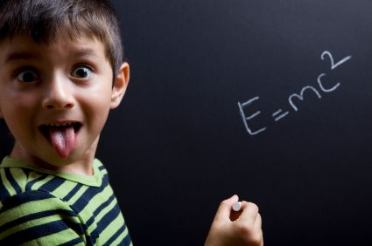
engagement = mutual connection between 2 people

Slide 4
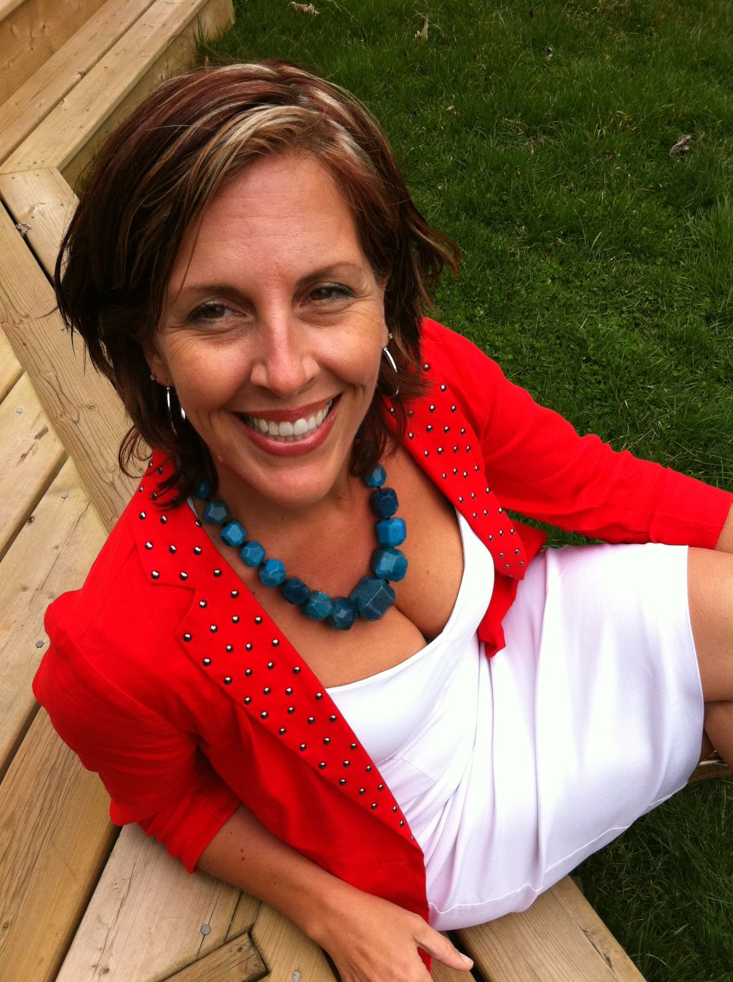
questions?
tweet me!
@juliarosien

Slide 5

crisis or opportunity?
for conversation…

Slide 6
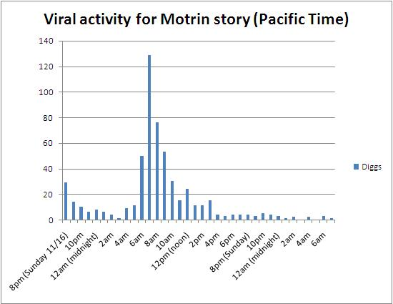
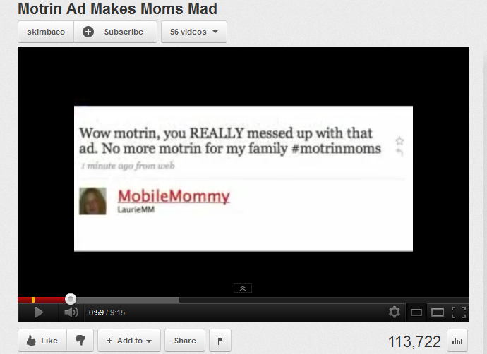
say whaaaaat?

Slide 7
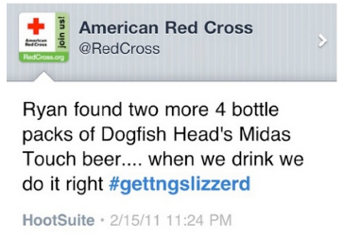

from pr disaster to…
fundraising opportunity!

Slide 8


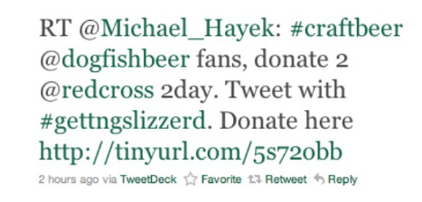
they partnered
with dogfish…

Slide 9
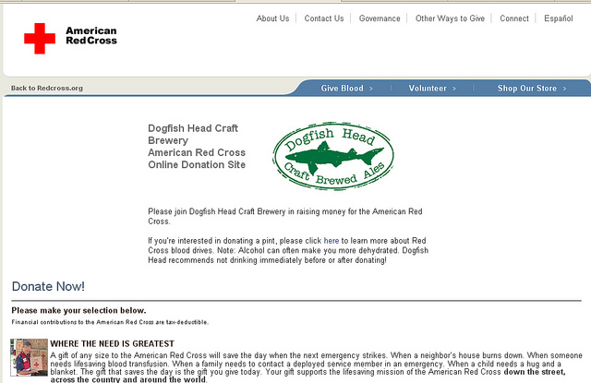
they used humour…

Slide 10

they admitted fault…
“We all know that it's impossible to really delete a tweet like this, so we acknowledged our mistake."

Slide 11
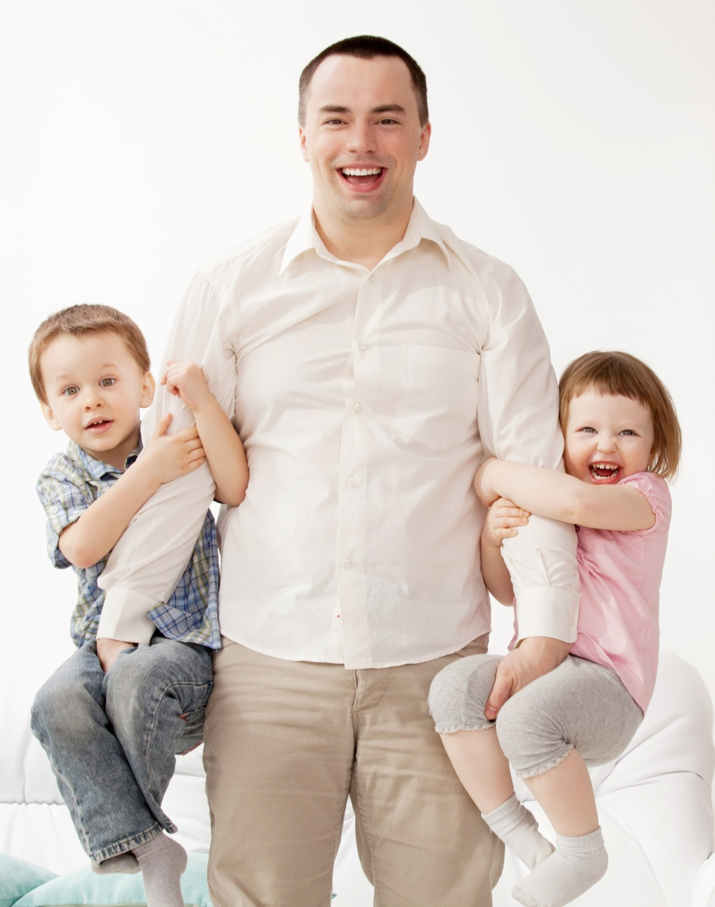
they thanked
their community…
"We're a 130 year old humanitarian organization made up of human beings. Thanks for getting that and for turning our faux pas into something good."

Slide 12
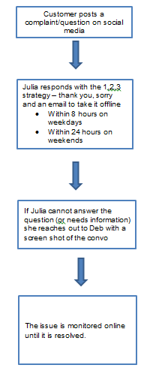

got a plan?
create
a decision
flow chart

Slide 13
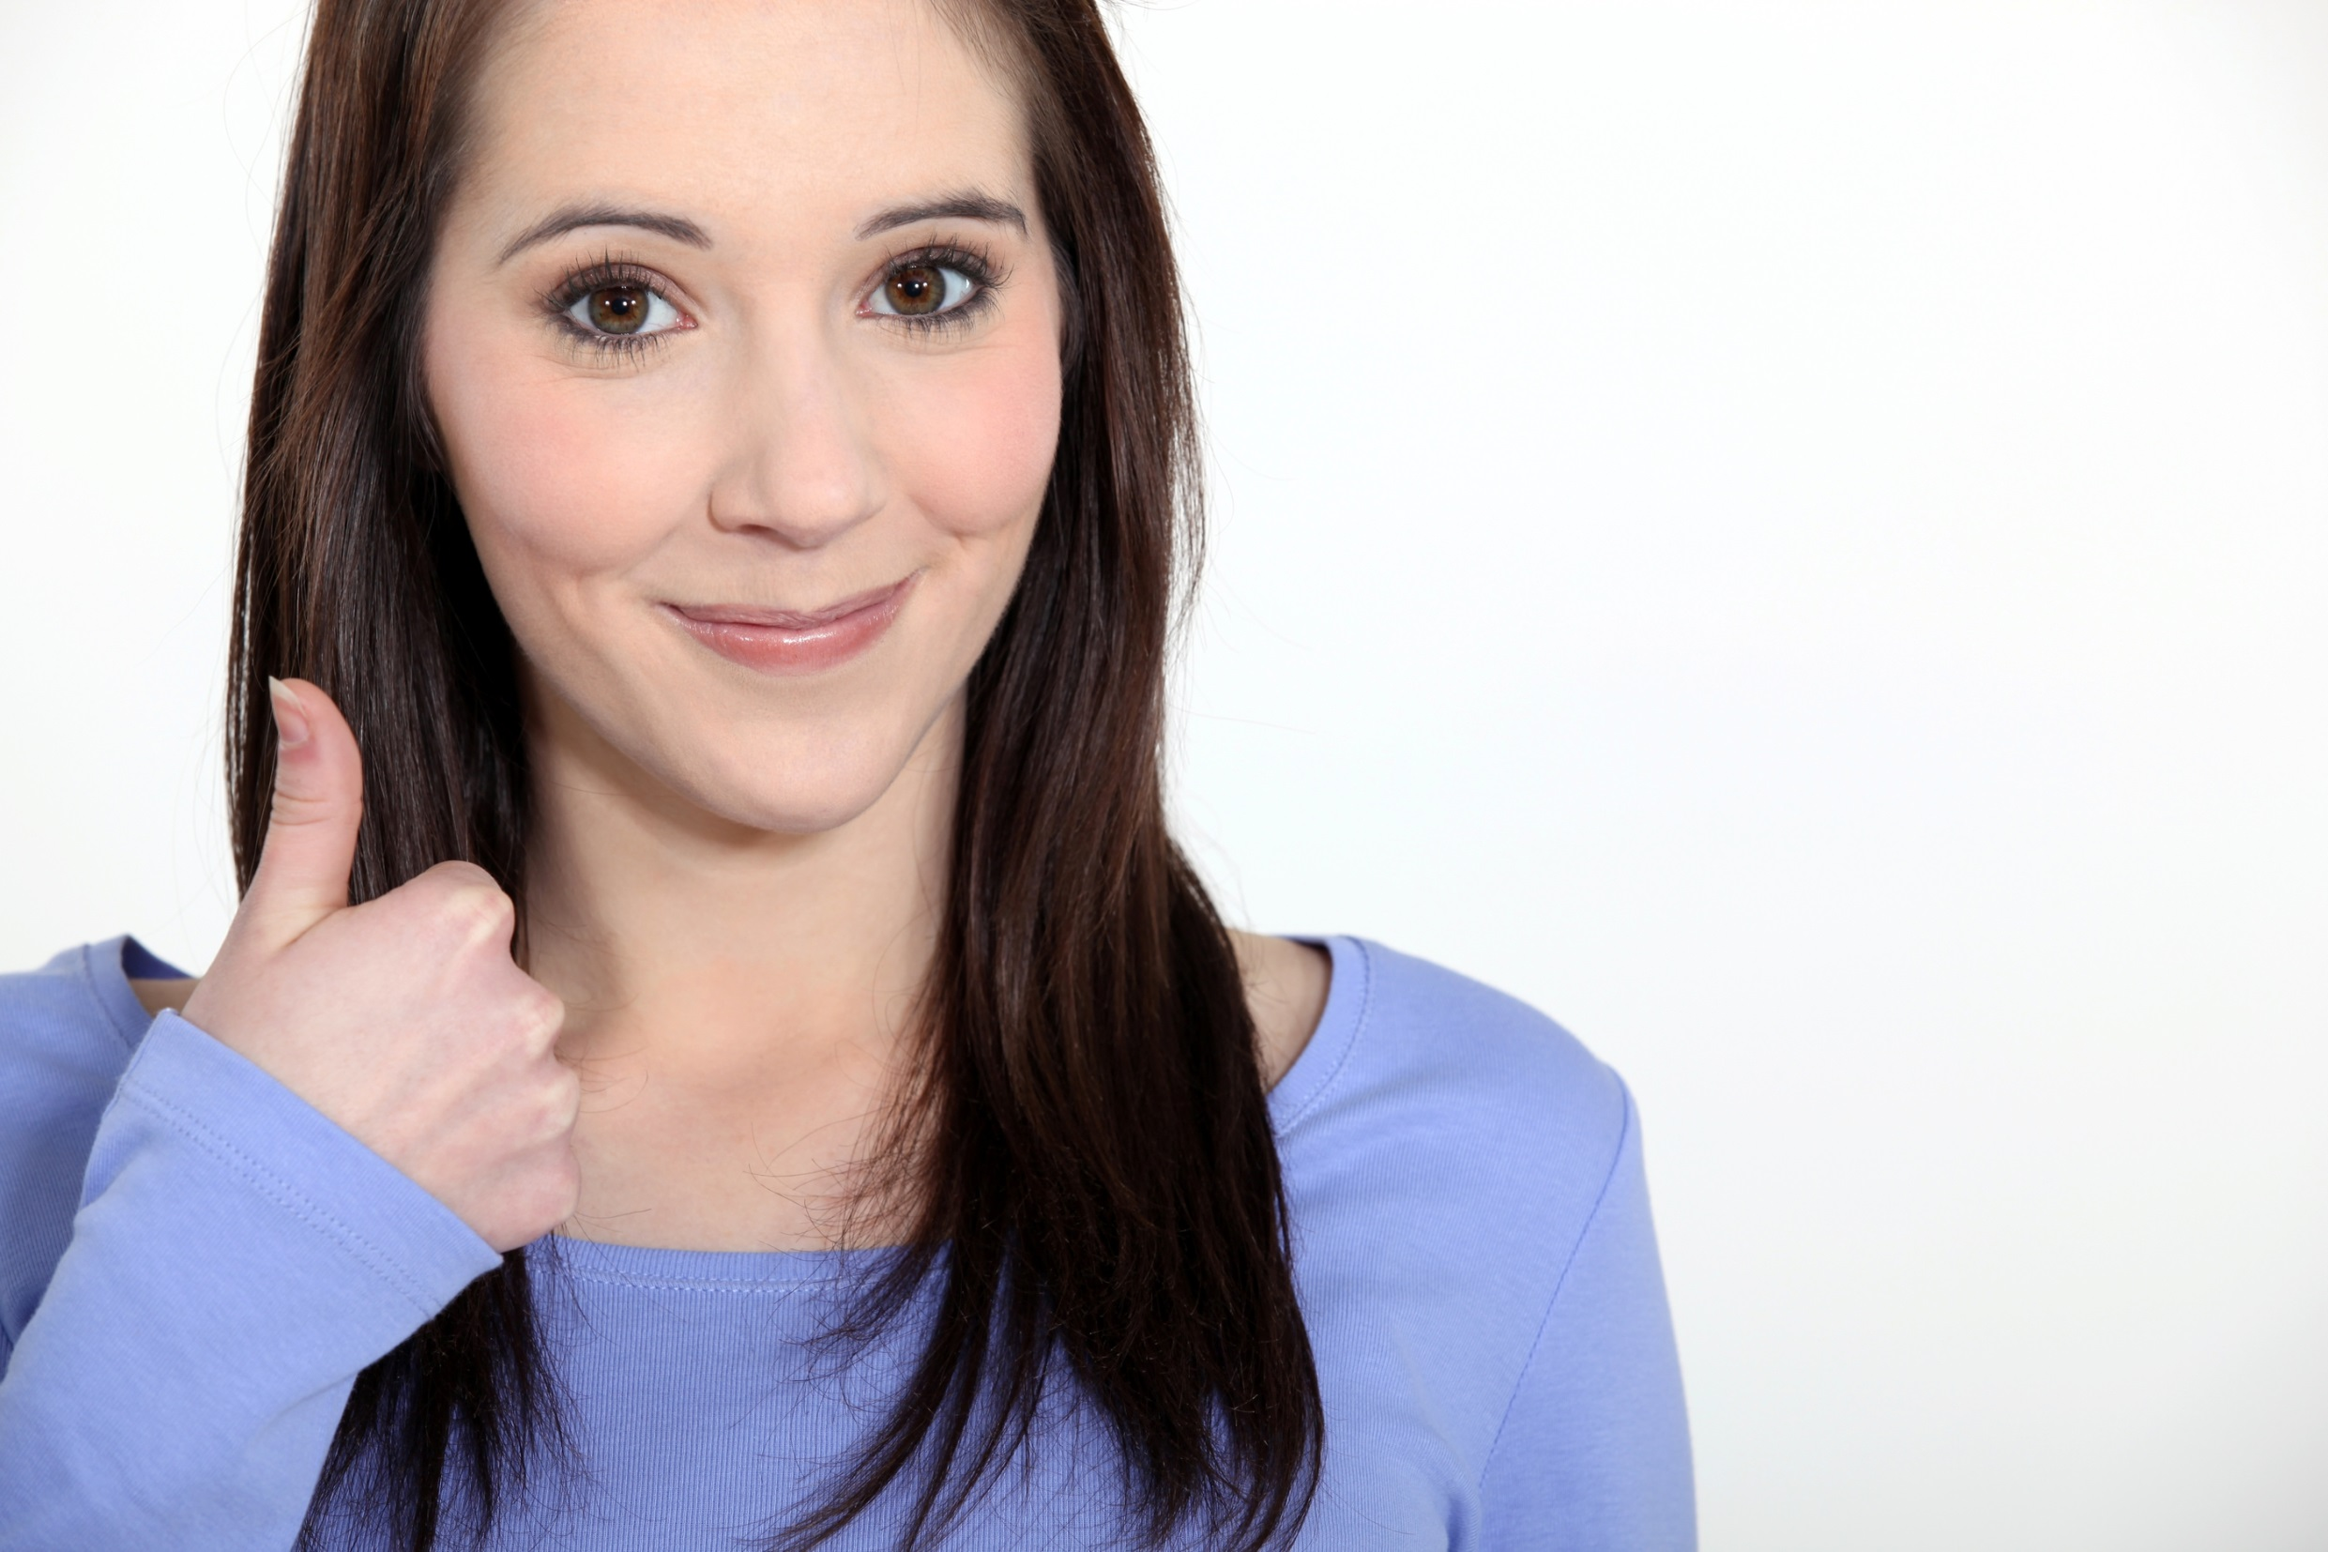
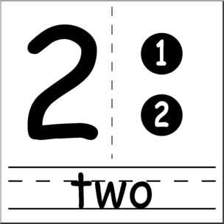
assign a
spokesperson
one voice
one message

Slide 14
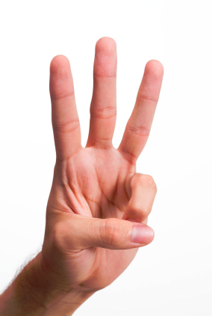
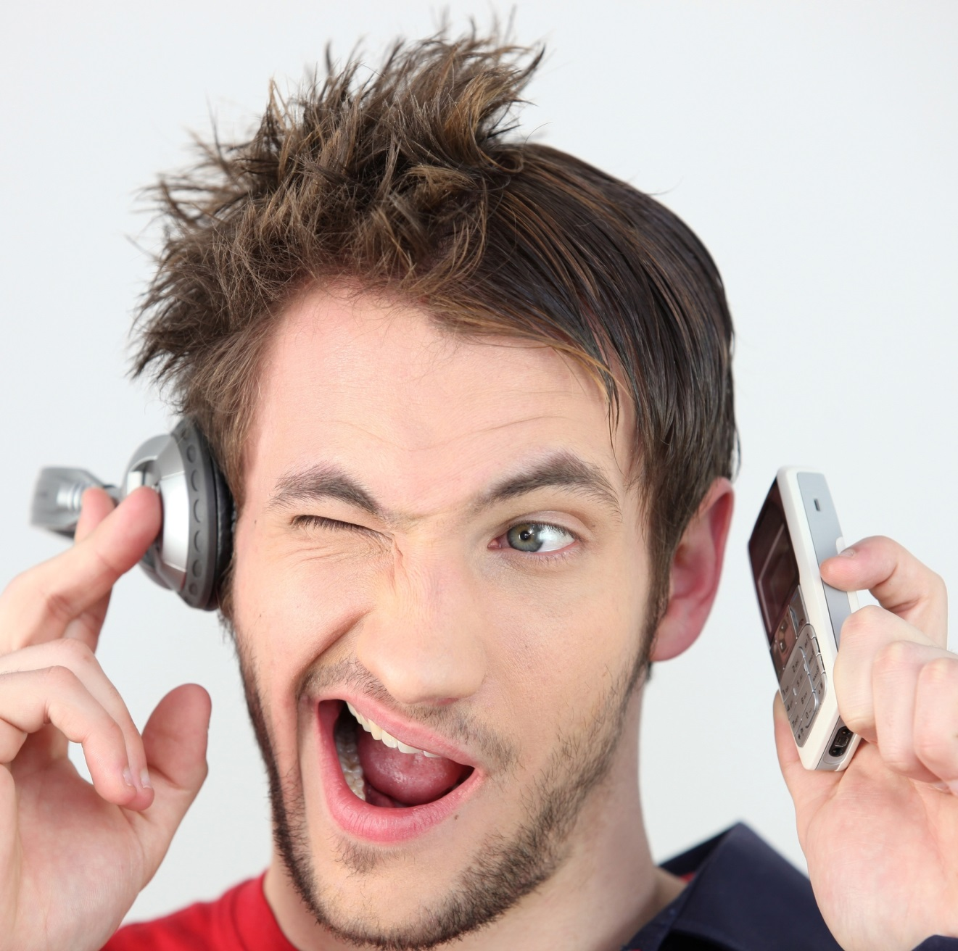
actively listen
ask questions
give answers
be social

Slide 15
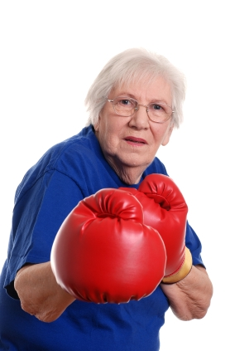
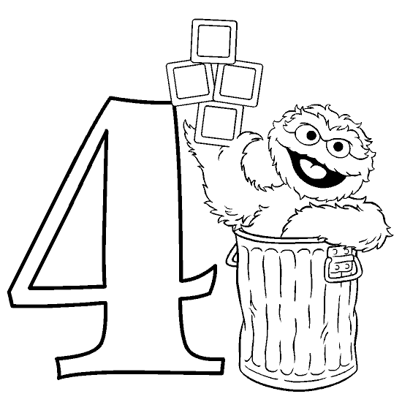
1, 2, 3 apology
say thank you
say I’m sorry
take it offline

Slide 16
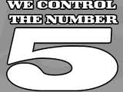
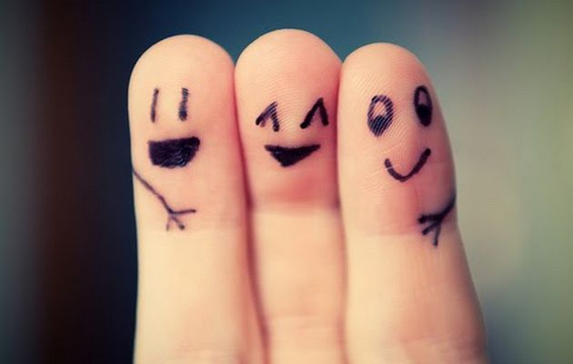
do fire drills
practice
practice
practice

Slide 17

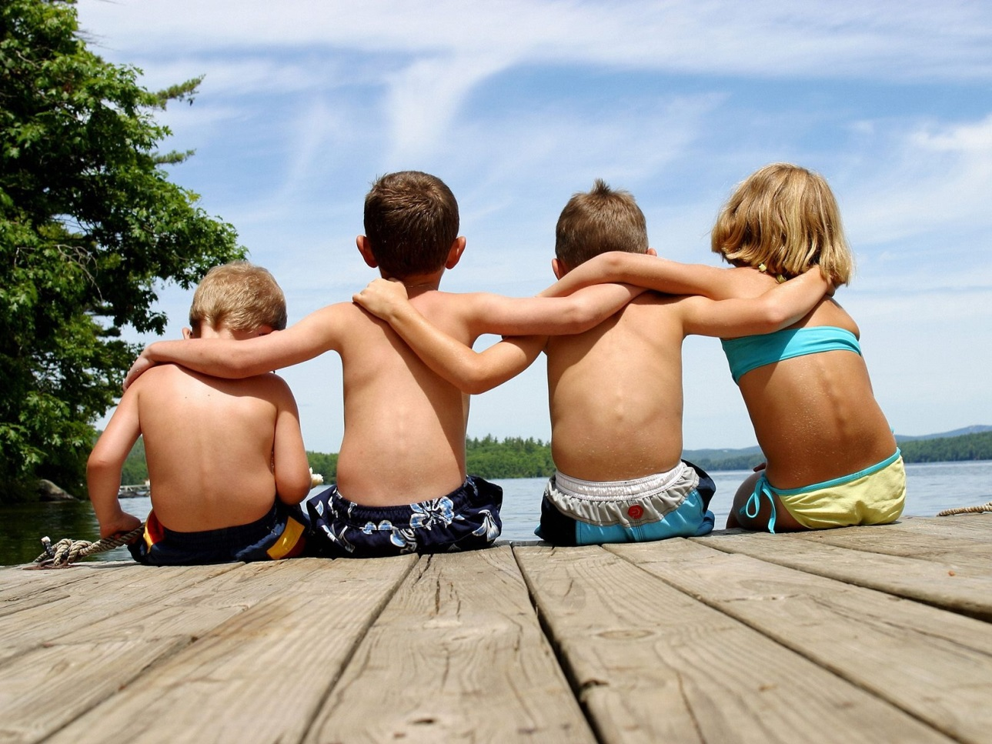
respect the clock
all hands on deck

Slide 18
engagement = mutual connection between 2 people

Slide 19
let’s talk!
Julia Rosien
c: 519-496-5797
e: jrosien@gogirlfriend.com
tweet me: @juliarosien

