Slide 1


01
CHATTER
& CHANNELS

Slide 2


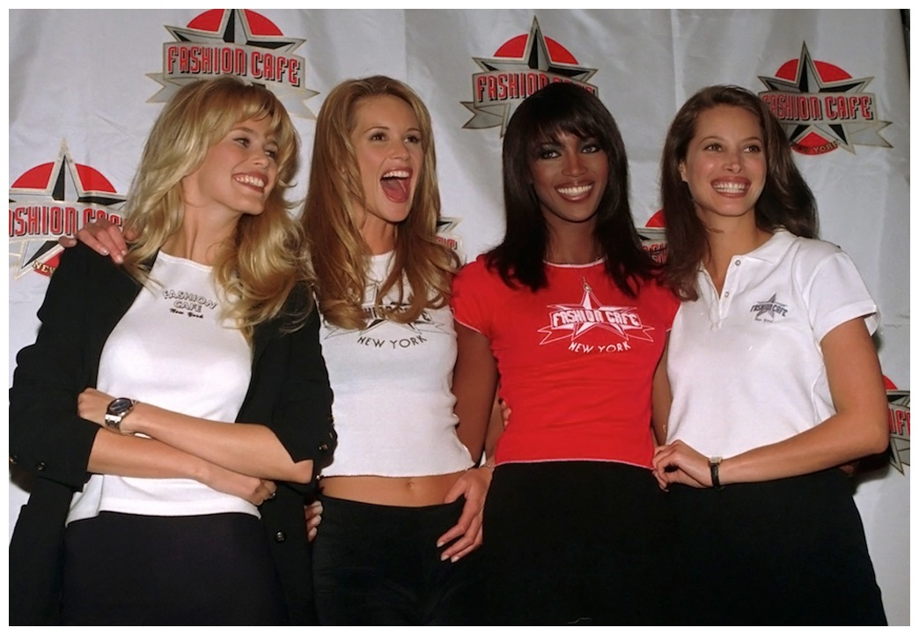
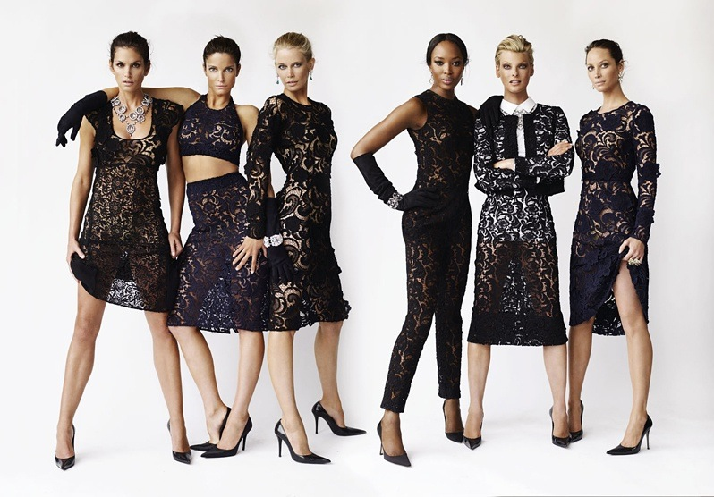
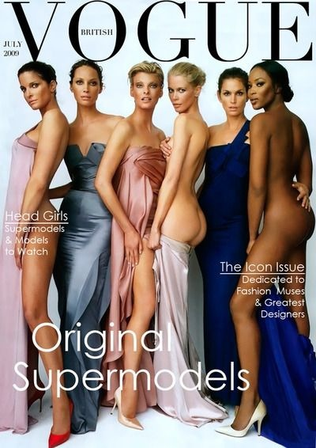
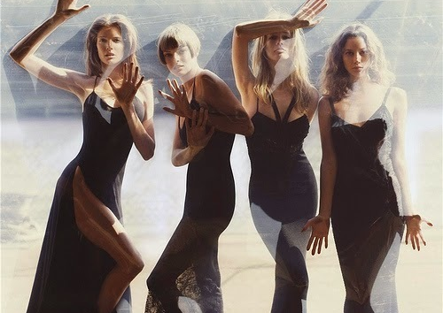
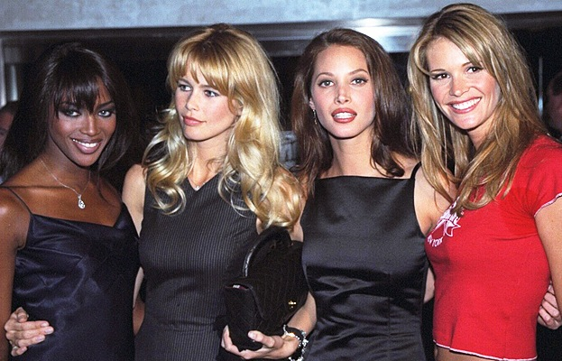
02
Supermodels
The Originals

Slide 3

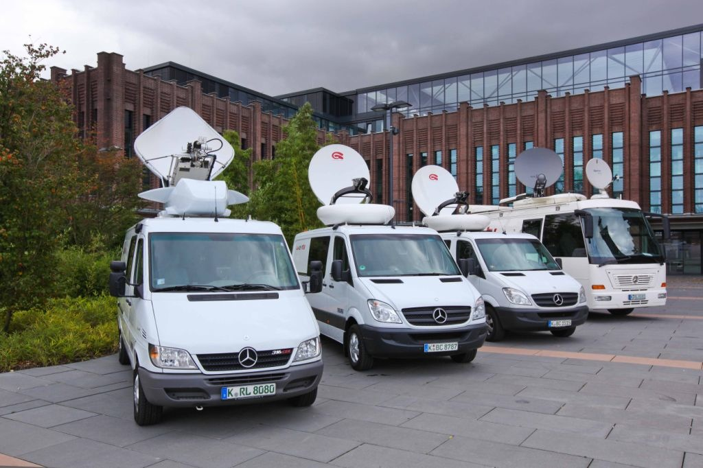



03
Satellites
Portals, Auctions, Exchanges & Trading Floors

Slide 4



04
Corporations
Fortune 500 Marketing & Communications

Slide 5

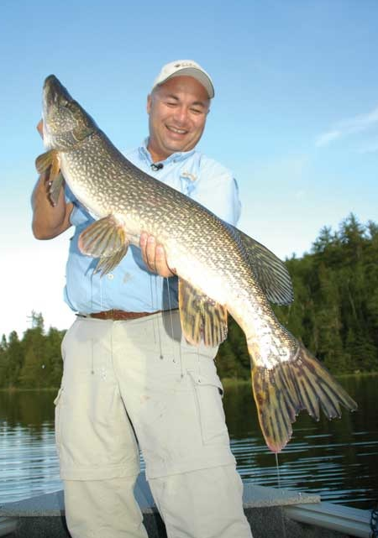
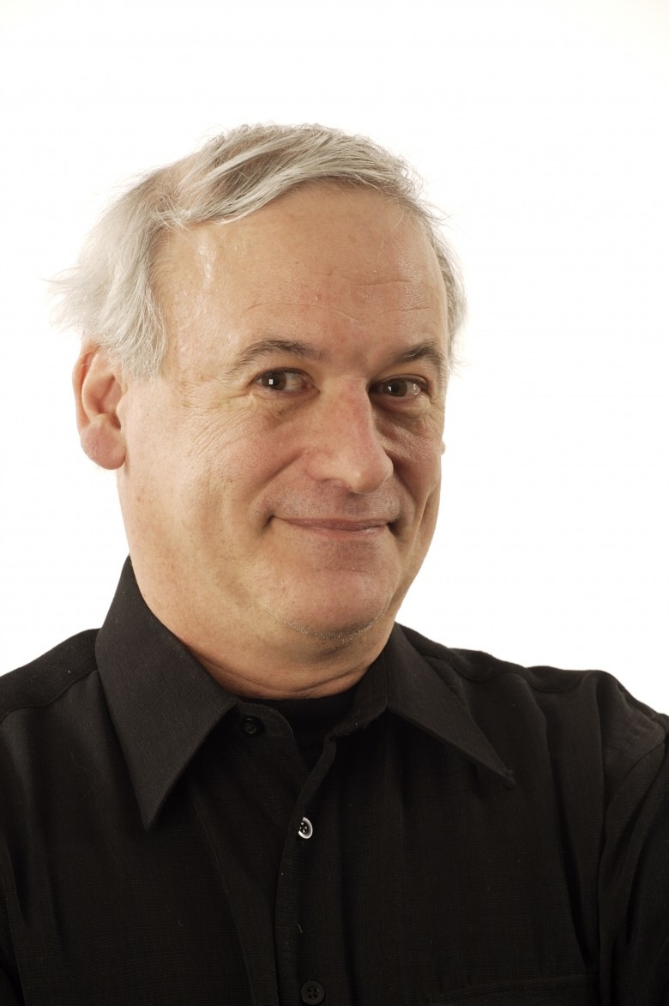
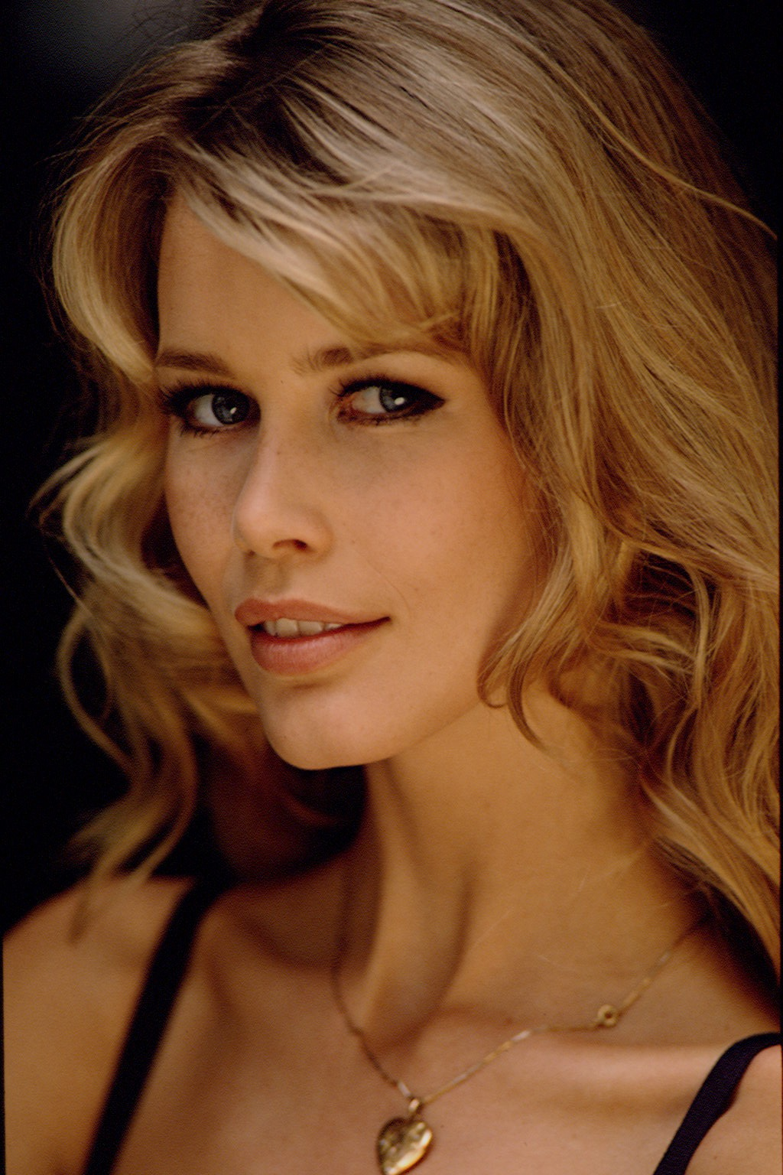
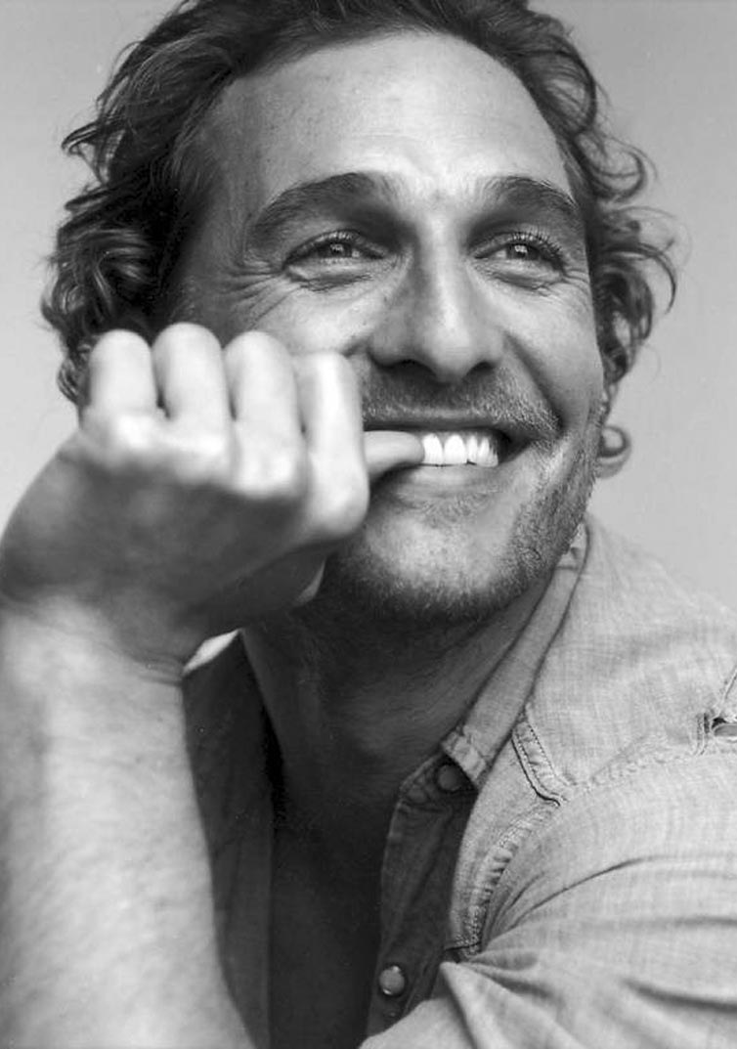
05
Mega Media Stars
Marketing Technology & Brand Building
Bob
Izumi
Robert
Munsch
Claudia
Schiffer
Matthew
McConaughey
Professional Angler
Children's Author
Model
Actor

Slide 6
06
Social Connections
Creating Your Channels
What did I learn about marketing & technology from all of these experiences?
And how does this relate to your social media?
Supermodels
Corporations
Satellites
Mega Media Stars

Slide 7
07
Supermodels
Partnerships
THE SUM IS GREATER THAN ONE.
PARTNERSHIP WILL MAKE YOU SUPER.

Slide 8
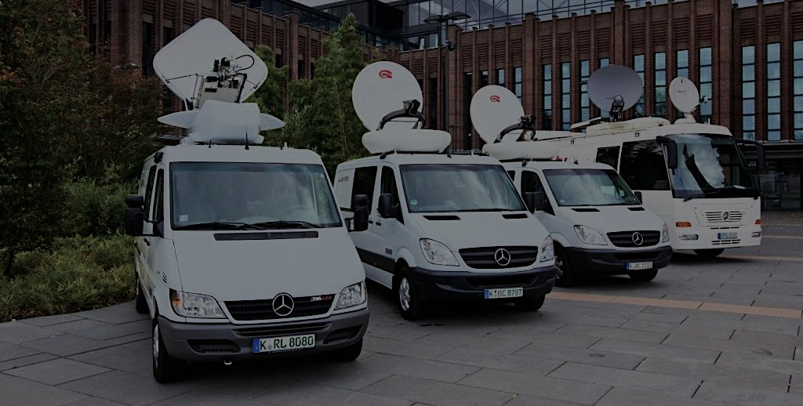

08
Satellites
Keep Your Channels Connected
BE PREPARED.
BE RESPONSIVE.
And stay connected to the right channels BEFORE the 'event' happens.

Slide 9
09
Corporations
Audience Development
KNOW YOUR AUDIENCE.
IT’S NOT ABOUT YOU.

Slide 10

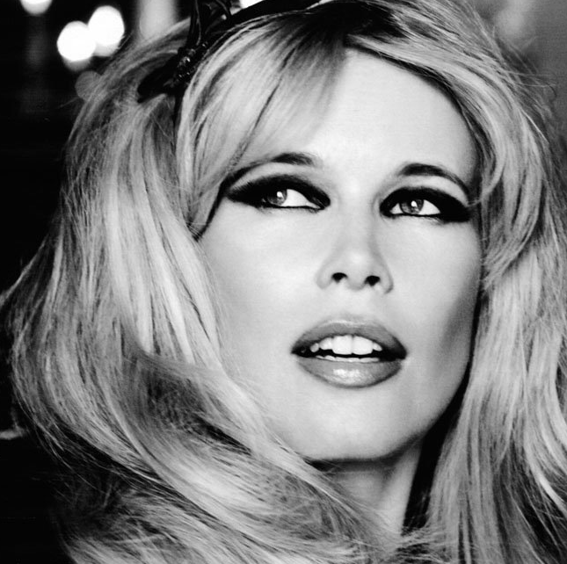
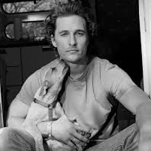
10
Mega Media Stars
Power Your Social Media Brand
TECHNOLOGY PLATFORMS WILL EMPOWER YOU.
& YOU CAN EXPAND YOUR REACH GLOBALLY.
BE AUTHENTIC & BE YOUR BRAND.

Slide 11

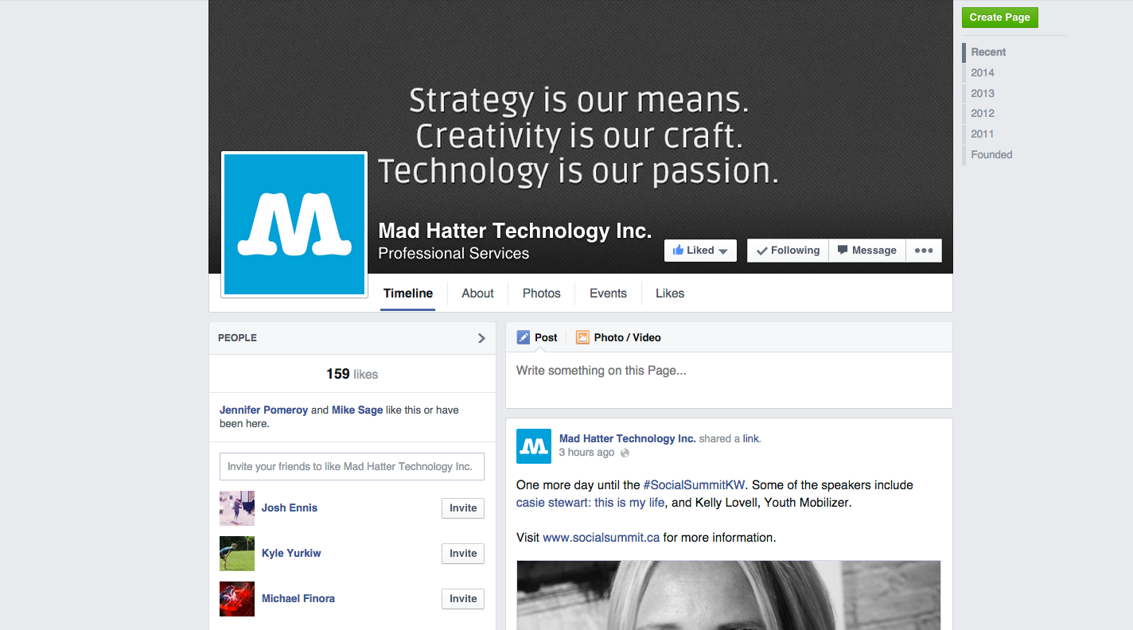
11
Social Media Channels
Facebook

Slide 12

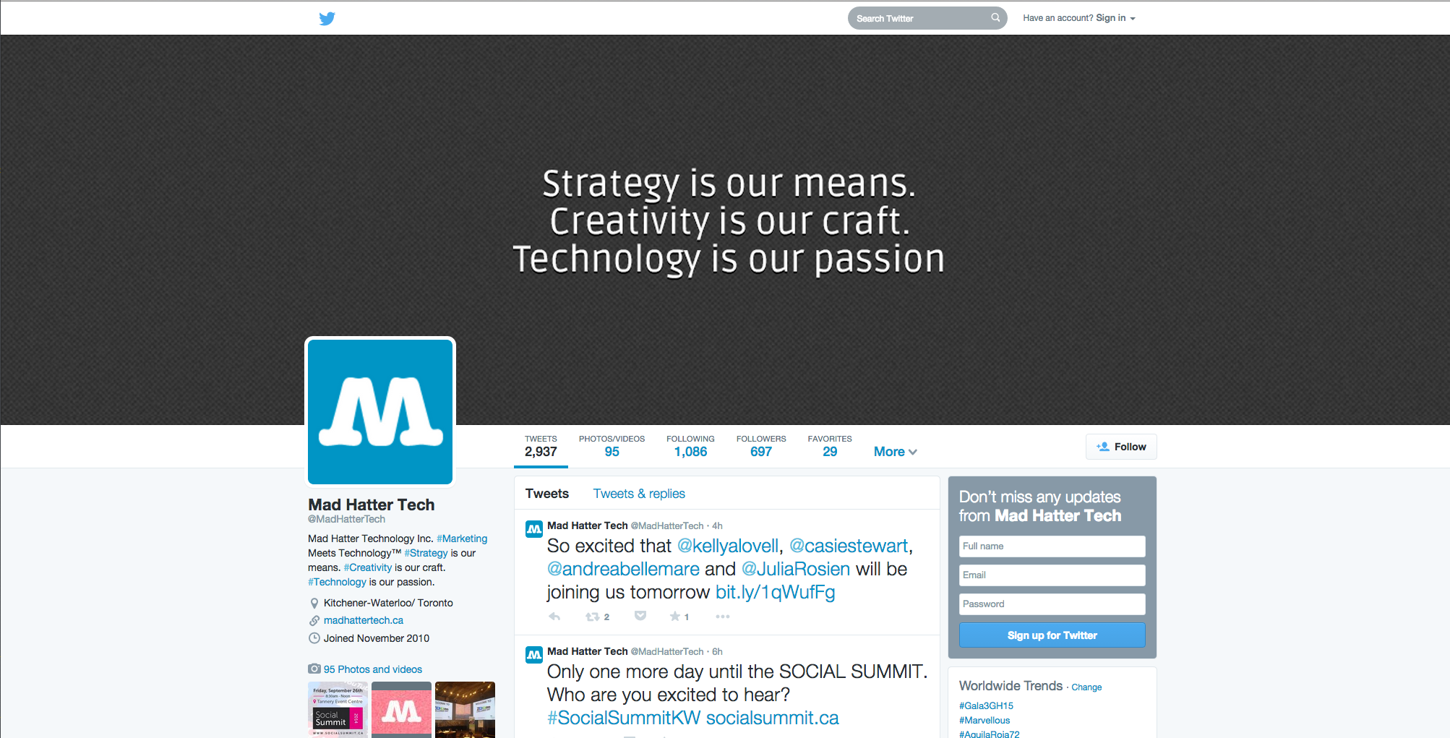
12
Social Media Channels
Twitter

Slide 13

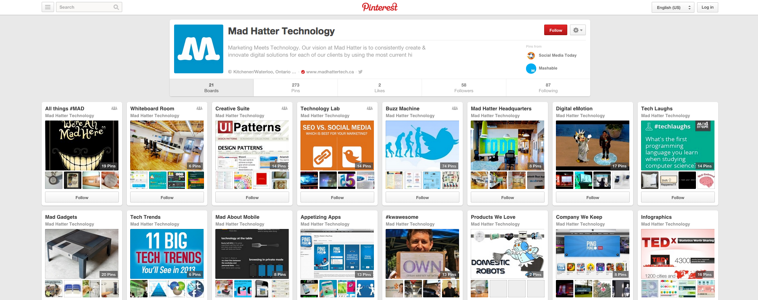
13
Social Media Channels
Pinterest

Slide 14

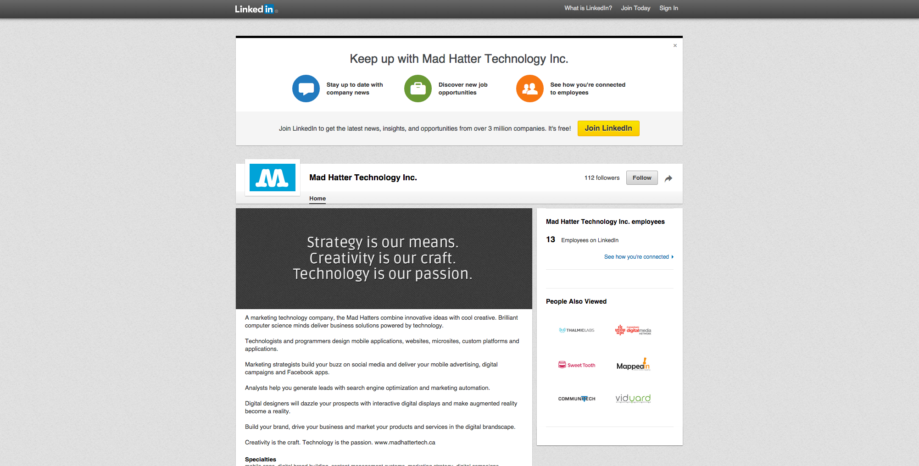
14
Social Media Channels
LinkedIn

Slide 15

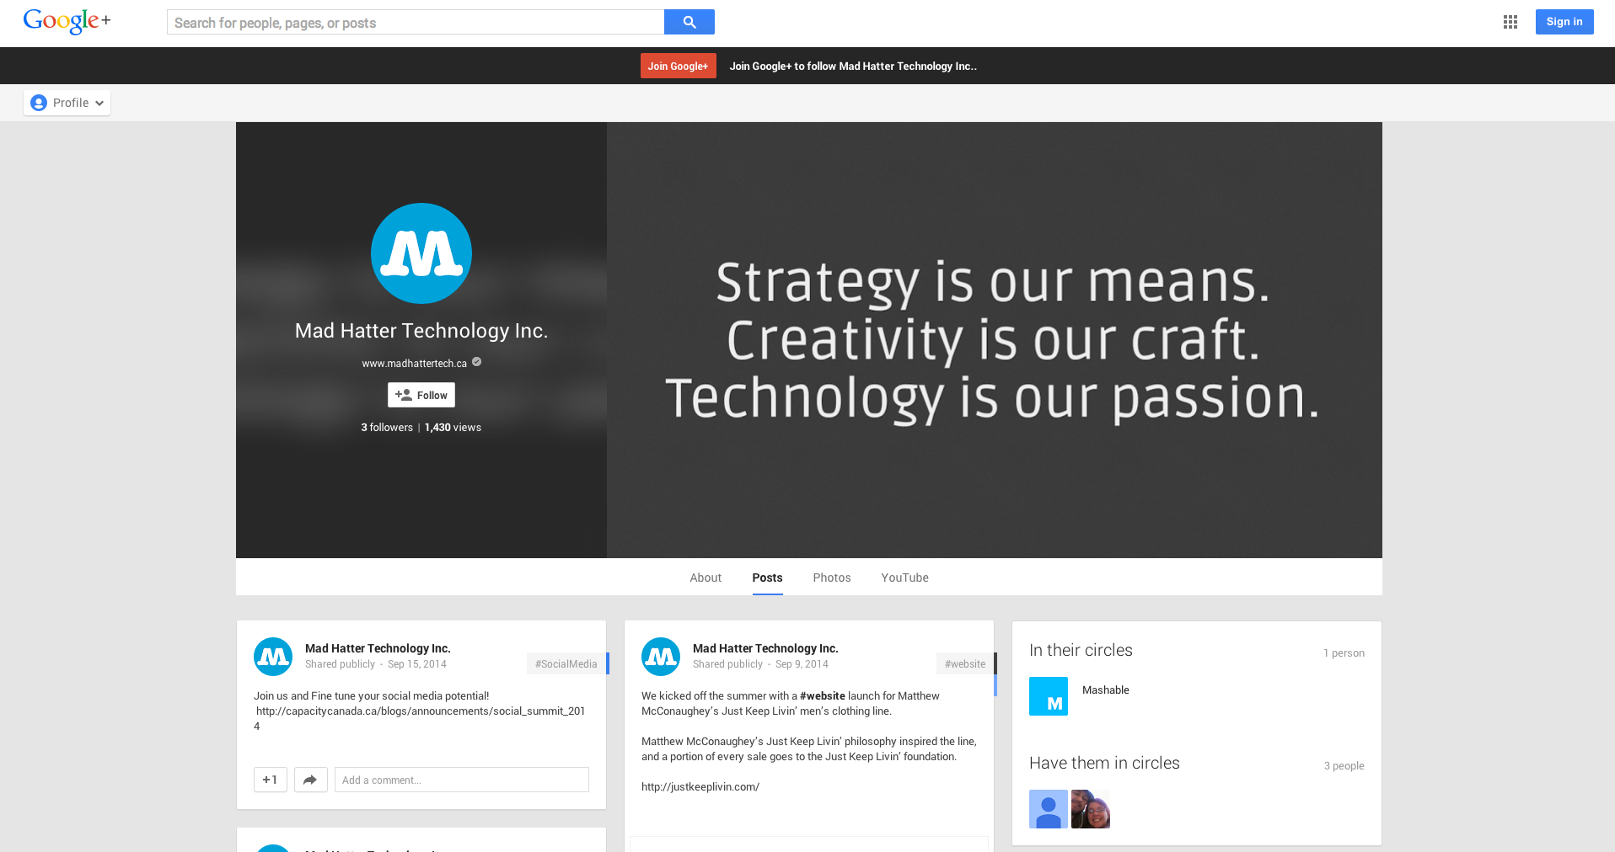
15
Social Media Channels
Google+

Slide 16

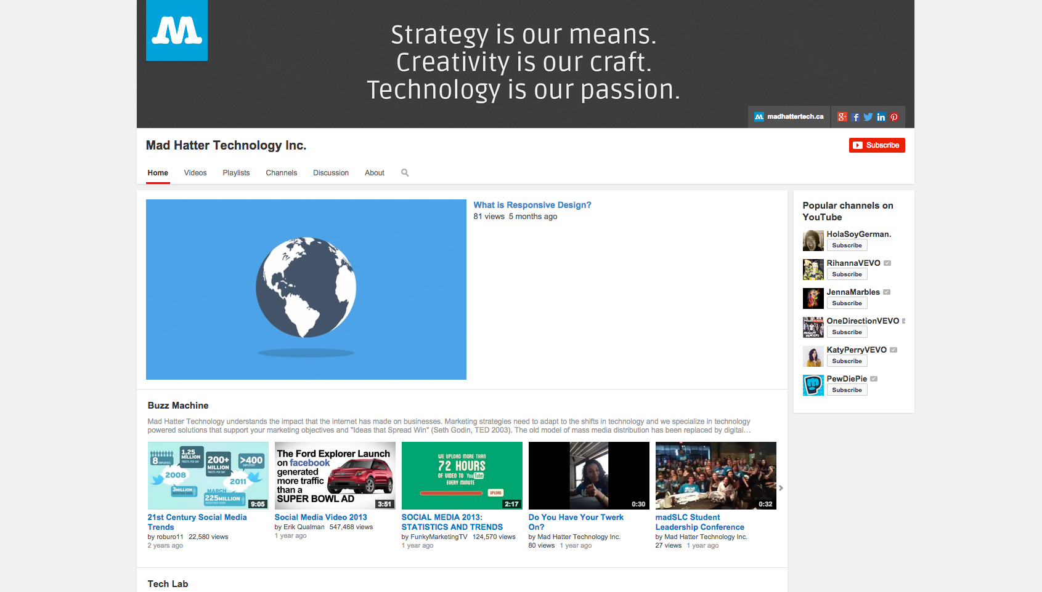
16
Social Media Channels
YouTube

Slide 17
17
Social Media Tips
Chatter & Channels
Be a supermodel. One of the originals.
Be prepared to be responsive & stay connected.
Talk on the right channels, to the right audience.
Stay true to you. Be authentic & you will build your brand.
Technology can take you anywhere in the world.
”
”

Slide 18

@MARCOMMTECH
@MADHATTERTECH
FACEBOOK.COM/MADHATTERTECH
linkedin.com/company/mad-hatter-technology-inc
DON’T BE A STRANGER, KEEP IN TOUCH!
MELANIE
WITZELL
(226) 444-0437
melanie@madhattertech.ca

Slide 19



19
Introducing Nicole
Content Curator, Mad Hatter Tech
Nicole works on public relations, digital engagement and social media strategy with clients at Mad Hatter Technology. Nicole has a passion for people and an enthusiasm for innovation. She began her career with a blend of experience in communications, public relations and event management.
After postgraduate studies in corporate communications and public relations at Centennial College, Nicole was attracted to the way that public relations has evolved and how social media has become integrated into corporate strategies. This passion led her to work within the corporate communications team at MasterCard Canada.
Known as a serial volunteer, Nicole is also a sports enthusiast, world traveler, foodaholic, kindle addict and fest goer.

Slide 20
01
5
TOOLS
TO HELP YOUR
BUZZ MACHINE

Slide 21



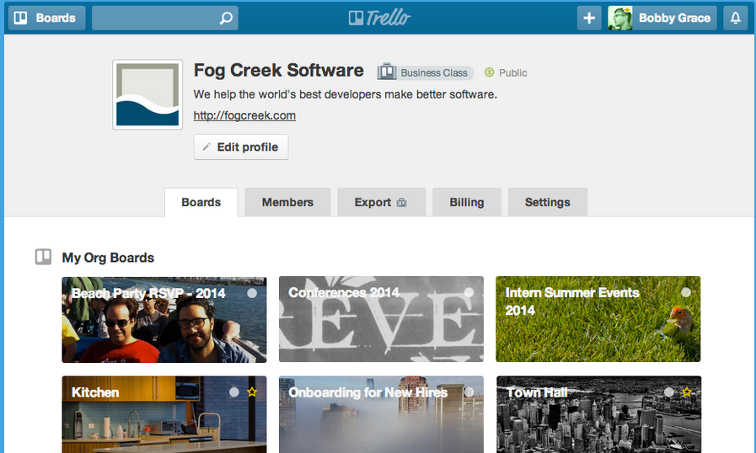

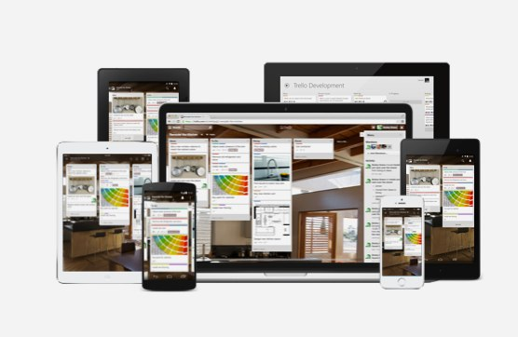
02
Trello
Trello.com

Slide 22

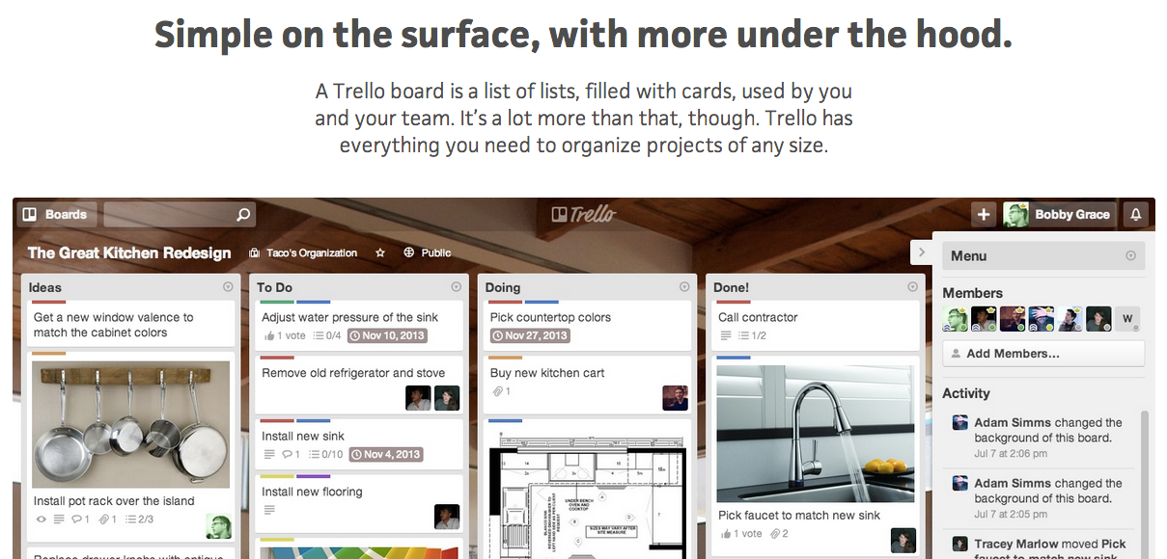
03
Trello
Trello.com

Slide 23


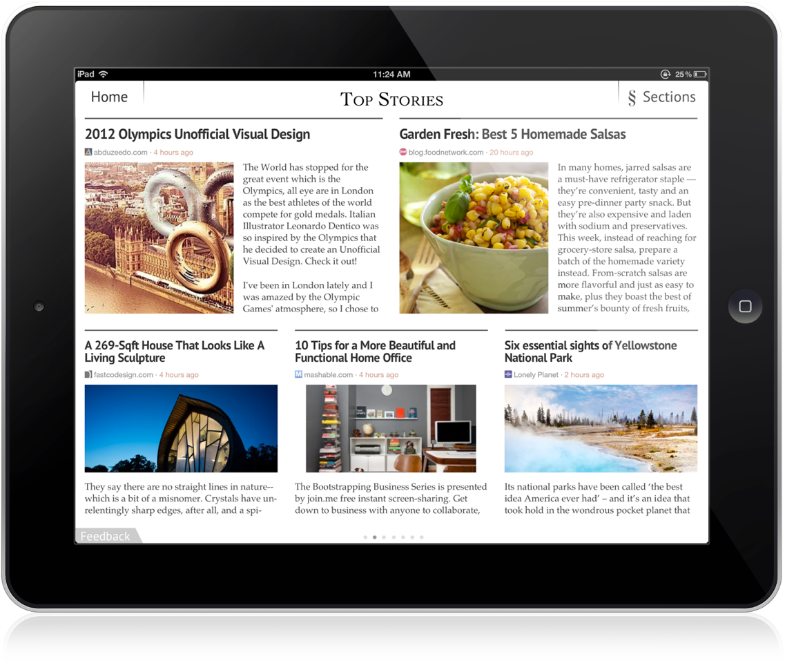
04
Zite
Zite.com
See Zite in Action

Slide 24



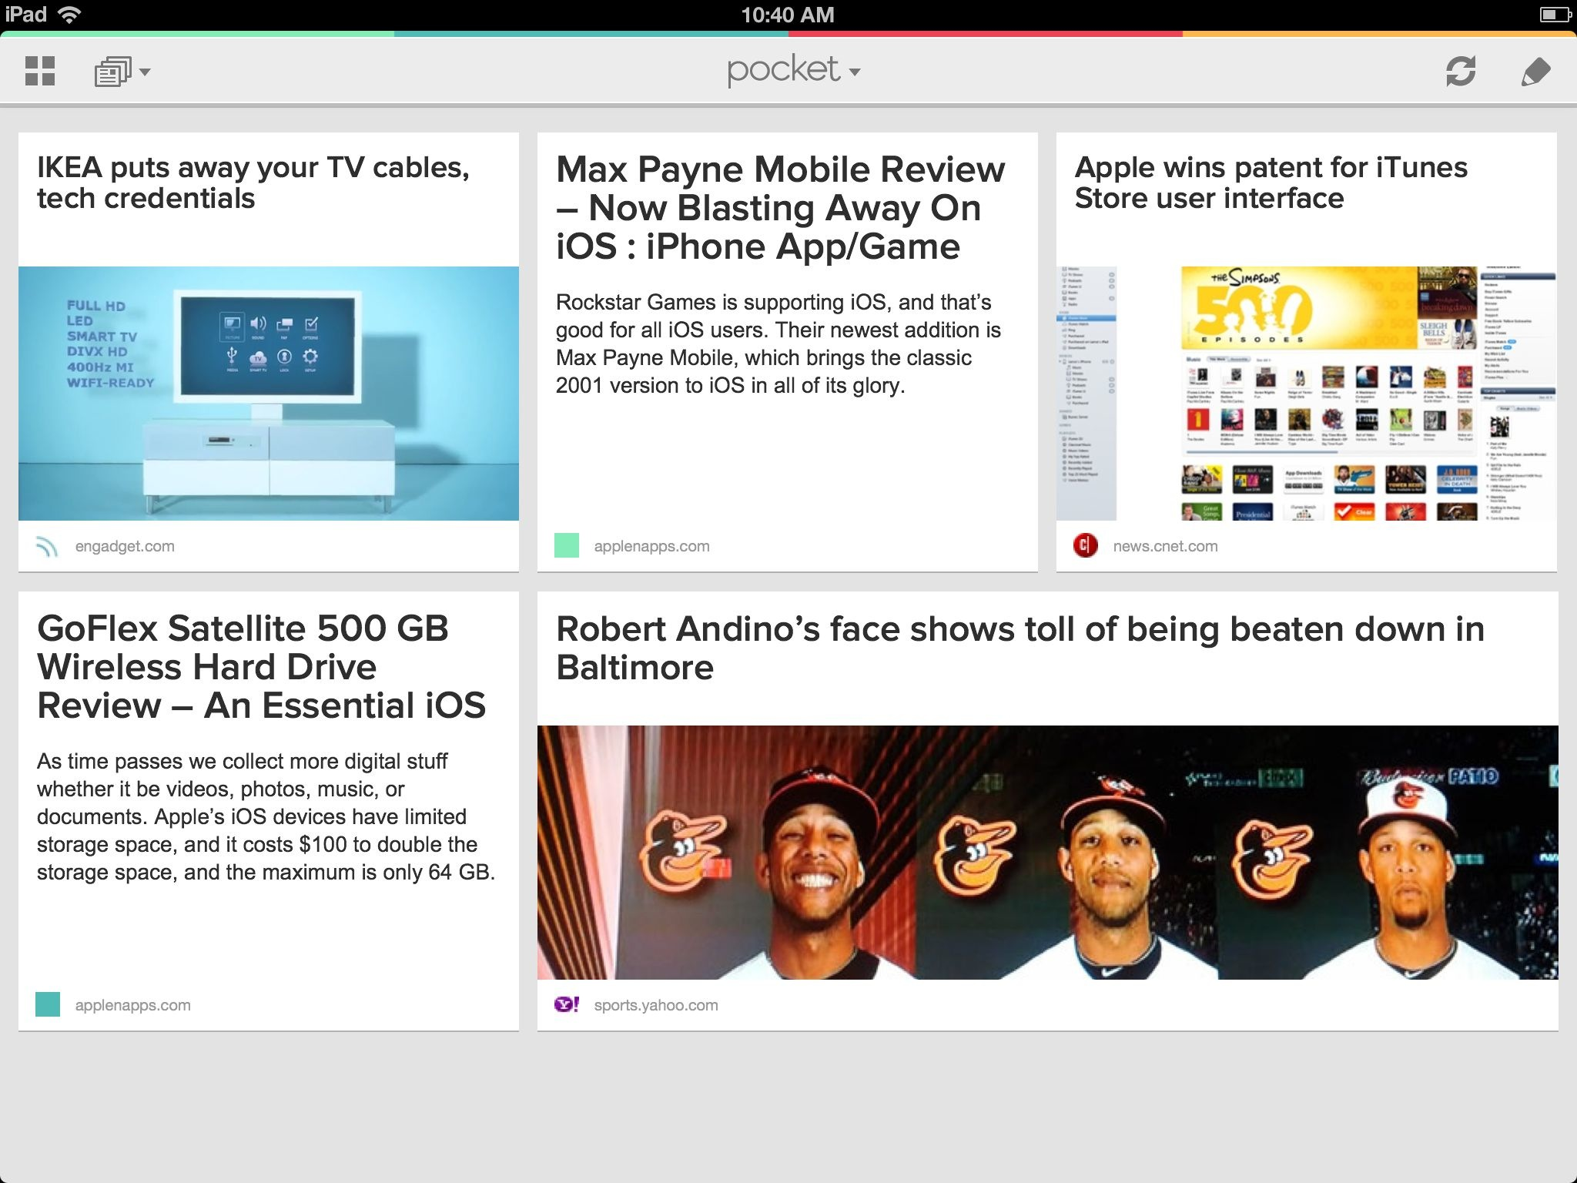
05
Pocket
GetPocket.com

Slide 25


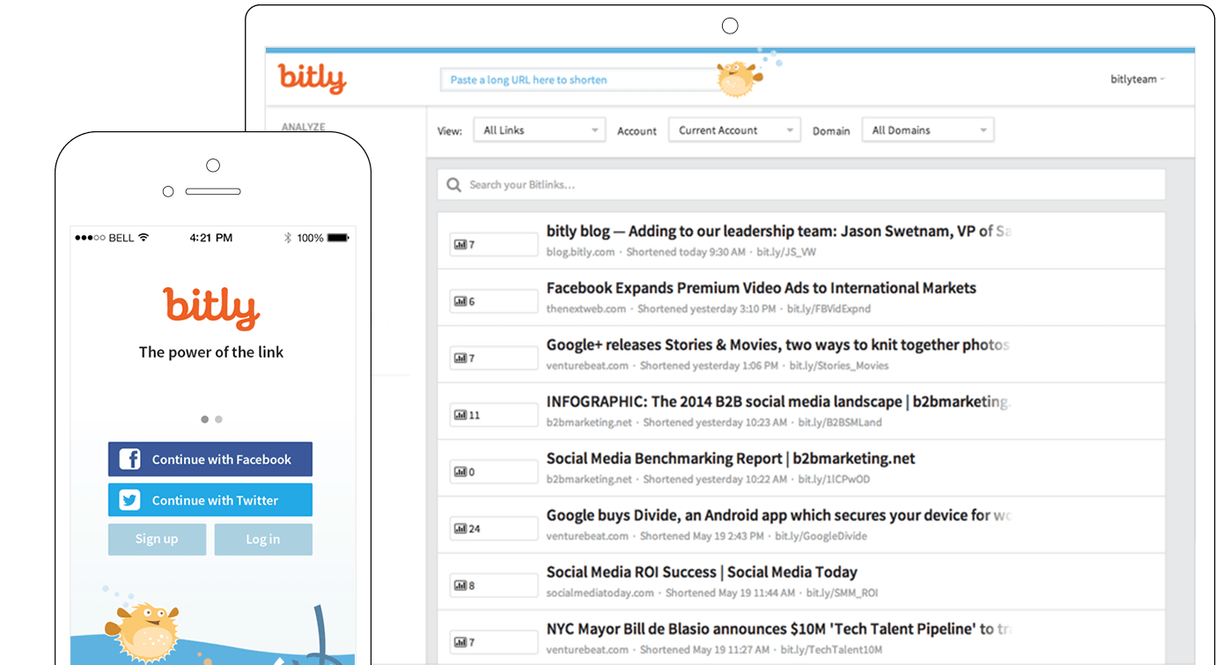
06
Bit.ly
bitly.com

Slide 26



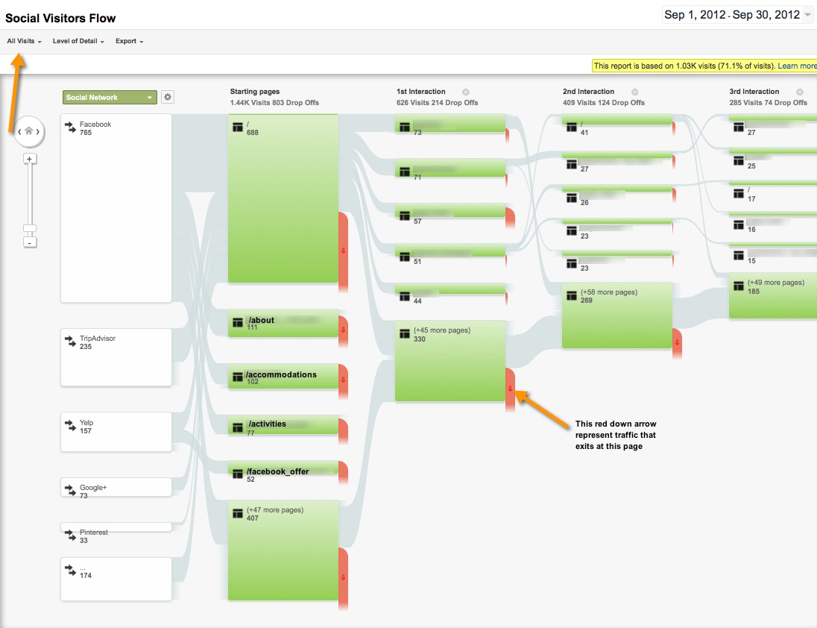
07
Google Analytics
google.com/analytics

Slide 27
DON’T BE A STRANGER, KEEP IN TOUCH!
@MADHATTERTECH
FACEBOOK.COM/MADHATTERTECH
linkedin.com/company/mad-hatter-technology-inc
NICOLE
STUBER
(226) 444-0434 x4343
nicole@madhattertech.ca

Slide 28
THANK YOU!

